Slide 1
somewhat advanced
dbatools development
Chrissy LeMaire
Fred Weinmann

Slide 2

Chrissy LeMaire
SQL Data Pro – Since 1999
DBA, Developer and Architect
PowerShell MVP – Since 2015
Most PowerShell work revolves around SQL Server with a bit of VMware & SharePoint
Sr. Systems Engineer
GDIT @ NATO Special Ops HQ
Module maker & maintainer
dbatools & dbachecks
/in/chrissylemaire
@cl
dbatools.io

Slide 3
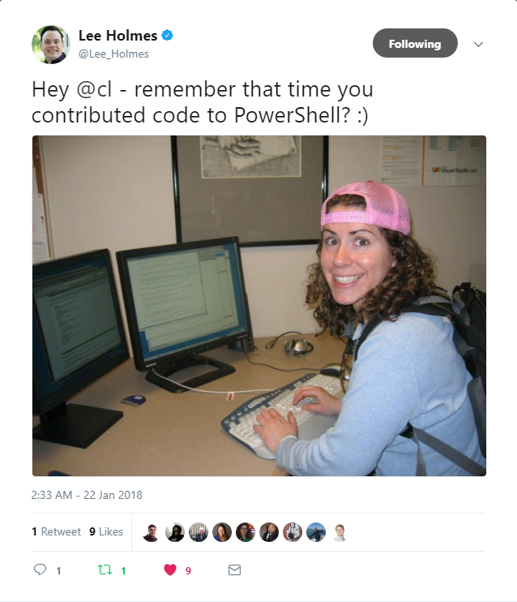
PowerShell since 2005
❤

Slide 4

Friedrich Weinmann
Stuttgart PowerShell UG
Lead
Sapien MVP
2017
Consultant & Software Architect
Module maker & maintainer
PSFramework, PSUtil, PSModuleDevelopment
@FredWeinmann
psframework.org

Slide 5
Agenda
intro
demo
Notes:
Quick intro and give some context

Slide 6

dbatools
sql community module
Notes:
Intro to dbatools

Slide 7
Began as Start-SqlMigration.ps1
Notes:
Basically, this presentation is not only about somewhat advanced dbatools development. Being at a PowerShell conference, we also wanted to show you how we handled creating what became quite a large project. How large? Let’s look at some numbers.

Slide 8
By the numbers
Over 100 contributors
Over 380 commands
Over 1000 files
Over 1000 Pester tests
Over 1300 channel members in #dbatools
Over 70000 downloads from PowerShell Gallery & other
Notes:
Transition to 9:
Great need for uniformity

Slide 9
User-friendly module
We try not to scare people
We’re backwards compatible*
Multiple easy documented ways to install
We provide help in #dbatools on SQL Community Slack
Notes:
But not forwards compat with core yet – waiting on SMO

Slide 10
Some advanced things we do
Runspaces for importing
Different importing for devs and end-users
No sea of red by default
Advanced logging
Configuration
Custom parameter types! Like DbaInstance
Notes:
No deets here

Slide 11

demo time!

Slide 12

Join our Slack channel
Invite yourself to Slack
dbatools.io/slack
Join #dbatools and #dbatools-dev
Ask questions, possibly get answers in real time ;)

Slide 13
Questions!

Slide 14
Thank you!

